Slide 1
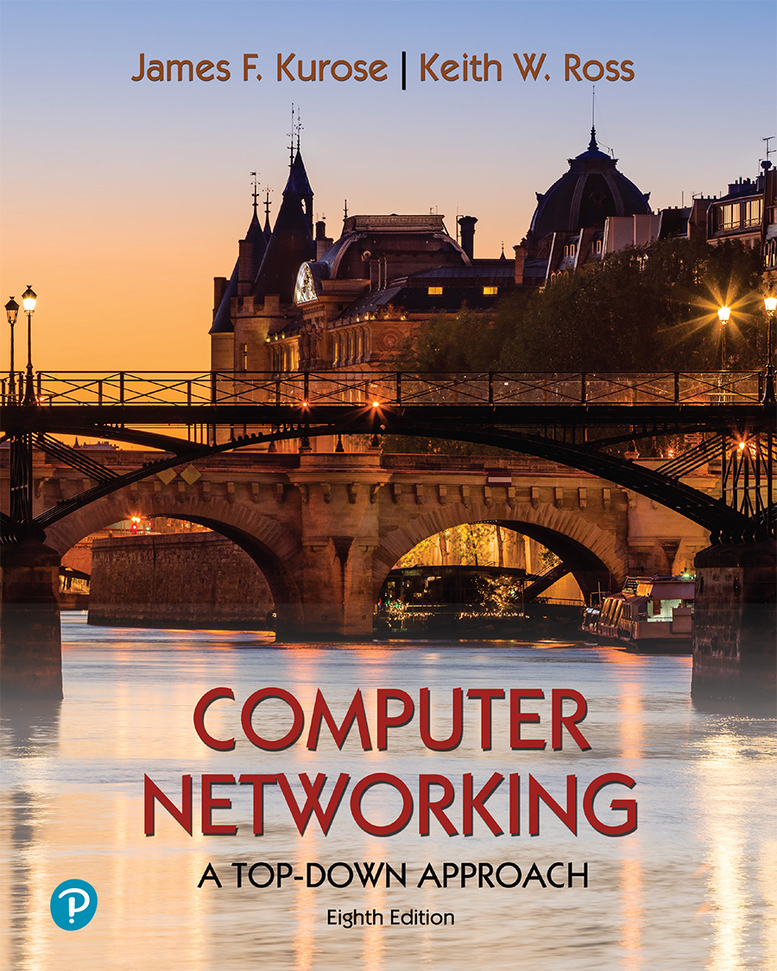
Chapter 8 Security
Computer Networking: A Top-Down Approach 8th edition Jim Kurose, Keith Ross Pearson, 2020
Acknowledgement: Based on the textbook’s website: https://gaia.cs.umass.edu/kurose_ross/index.php
Notes:
Version History
8.0 (May 2020)
All slides reformatted for 16:9 aspect ratio
All slides updated to 8th edition material
Use of Calibri font, rather that Gill Sans MT
Add LOTS more animation throughout
lighter header font
wireless security completely redone (updated WiFi and added 4G/5G)
SSL material replaces by TLS 1.3 (up-to-date)
V8.2 (Feb 2022)
Minor corrections

Slide 2
Security: overview
Chapter goals:
understand principles of network security:
cryptography and its many uses beyond “confidentiality”
authentication
message integrity
security in practice:
firewalls and intrusion detection systems
security in application, transport, network, link layers

Slide 3

Chapter 8 outline
What is network security?
Principles of cryptography
Message integrity, authentication
Securing e-mail
Securing TCP connections: TLS
Network layer security: IPsec
Security in wireless and mobile networks
Operational security: firewalls and IDS

Slide 4
What is network security?
confidentiality: only sender, intended receiver should “understand” message contents
sender encrypts message
receiver decrypts message
authentication: sender, receiver want to confirm identity of each other
message integrity: sender, receiver want to ensure message not altered (in transit, or afterwards) without detection
access and availability: services must be accessible and available to users

Slide 5



Friends and enemies: Alice, Bob, Trudy
well-known in network security world
Bob, Alice (lovers!) want to communicate “securely”
Trudy (intruder) may intercept, delete, add messages
Alice
channel
data, control messages
Bob
secure
sender
secure
receiver
data
data
Trudy

Slide 6
Friends and enemies: Alice, Bob, Trudy
Who might Bob and Alice be?
… well, real-life Bobs and Alices!
Web browser/server for electronic transactions (e.g., on-line purchases)
on-line banking client/server
DNS servers
BGP routers exchanging routing table updates
other examples?

Slide 7
There are bad guys (and girls) out there!
Q: What can a “bad guy” do?
A: A lot! (recall section 1.6)
eavesdrop: intercept messages
actively insert messages into connection
impersonation: can fake (spoof) source address in packet (or any field in packet)
hijacking: “take over” ongoing connection by removing sender or receiver, inserting himself in place
denial of service: prevent service from being used by others (e.g., by overloading resources)

Slide 8
Chapter 8 outline
What is network security?
Principles of cryptography
Message integrity, authentication
Securing e-mail
Securing TCP connections: TLS
Network layer security: IPsec
Security in wireless and mobile networks
Operational security: firewalls and IDS

Slide 9
The language of cryptography
Alice’s
encryption
key
Bob’s
decryption
key
K
A
K
B
plaintext
encryption
algorithm
ciphertext
decryption
algorithm
plaintext
m: plaintext message
K_{A}(m): ciphertext, encrypted with key K_{A}
m = K_{B}(K_{A}(m))

Slide 10
Breaking an encryption scheme
cipher-text only attack: Trudy has ciphertext she can analyze
two approaches:
brute force: search through all keys
statistical analysis
known-plaintext attack: Trudy has plaintext corresponding to ciphertext
e.g., in monoalphabetic cipher, Trudy determines pairings for a,l,i,c,e,b,o,
chosen-plaintext attack: Trudy can get ciphertext for chosen plaintext

Slide 11
Symmetric key cryptography
K
K
S
S
plaintext
encryption
algorithm
ciphertext
decryption
algorithm
plaintext
K (m)
S
symmetric key crypto: Bob and Alice share same (symmetric) key: K
e.g., key is knowing substitution pattern in mono alphabetic substitution cipher
Q: how do Bob and Alice agree on key value?

Slide 12
Simple encryption scheme
substitution cipher: substituting one thing for another
monoalphabetic cipher: substitute one letter for another
plaintext: abcdefghijklmnopqrstuvwxyz
ciphertext: mnbvcxzasdfghjklpoiuytrewq
e.g.:
Plaintext: bob. i love you. alice
ciphertext: nkn. s gktc wky. mgsbc
Encryption key: mapping from set of 26 letters
to set of 26 letters

Slide 13
A more sophisticated encryption approach
n substitution ciphers, M₁,M₂,…,M_{n}
cycling pattern:
e.g., n=4: M₁,M₃,M₄,M₃,M₂; M₁,M₃,M₄,M₃,M₂; ..
for each new plaintext symbol, use subsequent substitution pattern in cyclic pattern
dog: d from M₁, o from M₃, g from M₄
Encryption key: n substitution ciphers, and cyclic pattern
key need not be just n-bit pattern

Slide 14
Symmetric key crypto: DES
DES: Data Encryption Standard
US encryption standard [NIST 1993]
56-bit symmetric key, 64-bit plaintext input
block cipher with cipher block chaining
how secure is DES?
DES Challenge: 56-bit-key-encrypted phrase decrypted (brute force) in less than a day
no known good analytic attack
making DES more secure:
3DES: encrypt 3 times with 3 different keys

Slide 15
AES: Advanced Encryption Standard
symmetric-key NIST standard, replaced DES (Nov 2001)
processes data in 128 bit blocks
128, 192, or 256 bit keys
brute force decryption (try each key) taking 1 sec on DES, takes 149 trillion years for AES

Slide 16

Public Key Cryptography
symmetric key crypto:
requires sender, receiver know shared secret key
Q: how to agree on key in first place (particularly if never “met”)?
public key crypto
radically different approach [Diffie-Hellman76, RSA78]
sender, receiver do not share secret key
public encryption key known to all
private decryption key known only to receiver

Slide 17
Public Key Cryptography
+
Bob’s public key
K
B
-
Bob’s private key
K
B
plaintext
message, m
encryption
algorithm
ciphertext
decryption
algorithm
plaintext
+
-
+
K (m)
m = K (K (m))
B
B
B
Wow - public key cryptography revolutionized 2000-year-old (previously only symmetric key) cryptography!
similar ideas emerged at roughly same time, independently in US and UK (classified)

Slide 18
Public key encryption algorithms
requirements:
+
.
-
.
1
need K ( ) and K ( ) such that
B
B
-
+
K (K (m)) = m
B
B
+
2
given public key K , it should be impossible to compute private key K
B
-
B
RSA: Rivest, Shamir, Adelson algorithm

Slide 19
Prerequisite: modular arithmetic
x mod n = remainder of x when divide by n
facts:
[(a mod n) + (b mod n)] mod n = (a+b) mod n
[(a mod n) - (b mod n)] mod n = (a-b) mod n
[(a mod n) * (b mod n)] mod n = (a*b) mod n
thus
(a mod n)^{d} mod n = a^{d} mod n
example: x=14, n=10, d=2: (x mod n)^{d} mod n = 4² mod 10 = 6 x^{d} = 14² = 196 x^{d} mod 10 = 6

Slide 20
RSA: getting ready
message: just a bit pattern
bit pattern can be uniquely represented by an integer number
thus, encrypting a message is equivalent to encrypting a number
example:
m= 10010001. This message is uniquely represented by the decimal number 145.
to encrypt m, we encrypt the corresponding number, which gives a new number (the ciphertext).

Slide 21
RSA: Creating public/private key pair
1. choose two large prime numbers p, q. (e.g., 1024 bits each)
2. compute n = pq, z = (p-1)(q-1)
3. choose e (with e<n) that has no common factors with z (e, z are “relatively prime”).
4. choose d such that ed-1 is exactly divisible by z. (in other words: ed mod z = 1 ).
5. public key is (n,e). private key is (n,d).
+
-
K
K
B
B

Slide 22
RSA: encryption, decryption
0. given (n,e) and (n,d) as computed above
1. to encrypt message m (<n), compute
e
c = m mod n
2. to decrypt received bit pattern, c, compute
d
m = c mod n
magic happens!
e
d
m = (m mod n)
mod n
c

Slide 23
RSA example:
Bob chooses p=5, q=7. Then n=35, z=24.
e=5 (so e, z relatively prime).
d=29 (so ed-1 exactly divisible by z).
encrypting 8-bit messages.
m
e
e
bit pattern
m
c = m mod n
encrypt:
0000l000
12
24832
17
d
d
c
c
m = c mod n
decrypt:
17
481968572106750915091411825223071697
12

Slide 24
Why does RSA work?
must show that c^{d} mod n = m, where c = m^{e} mod n
fact: for any x and y: x^{y} mod n = x^{(y mod z)} mod n
where n= pq and z = (p-1)(q-1)
thus, c^{d} mod n = (m^{e} mod n)^{d} mod n
= m^{ed} mod n
= m^{(ed mod z)} mod n
= m¹ mod n
= m

Slide 25
RSA: another important property
The following property will be very useful later:
-
+
+
-
K (K (m)) = m
=
K (K (m))
B
B
B
B
use public key first, followed by private key
use private key first, followed by public key
result is the same!

Slide 26
Why
-
+
+
-
K (K (m)) = m
=
K (K (m))
?
B
B
B
B
follows directly from modular arithmetic:
(m^{e} mod n)^{d} mod n = m^{ed} mod n
= m^{de} mod n
= (m^{d} mod n)^{e} mod n

Slide 27
Why is RSA secure?
suppose you know Bob’s public key (n,e). How hard is it to determine d?
essentially need to find factors of n without knowing the two factors p and q
fact: factoring a big number is hard

Slide 28
RSA in practice: session keys
exponentiation in RSA is computationally intensive
DES is at least 100 times faster than RSA
use public key crypto to establish secure connection, then establish second key – symmetric session key – for encrypting data
session key, K_{S}
Bob and Alice use RSA to exchange a symmetric session key K_{S}
once both have K_{S}, they use symmetric key cryptography

